Slide 1
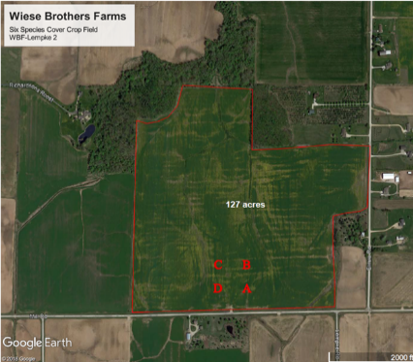
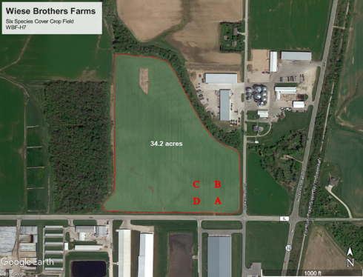
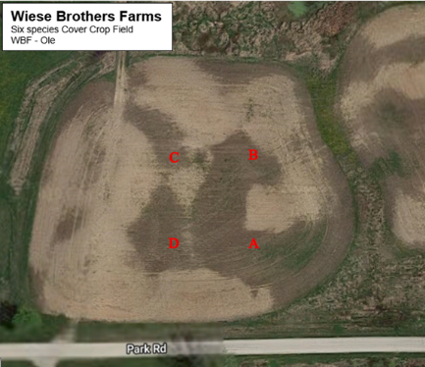
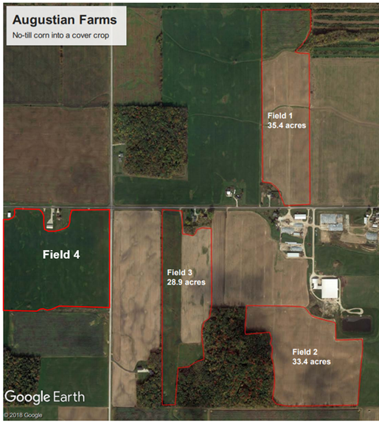
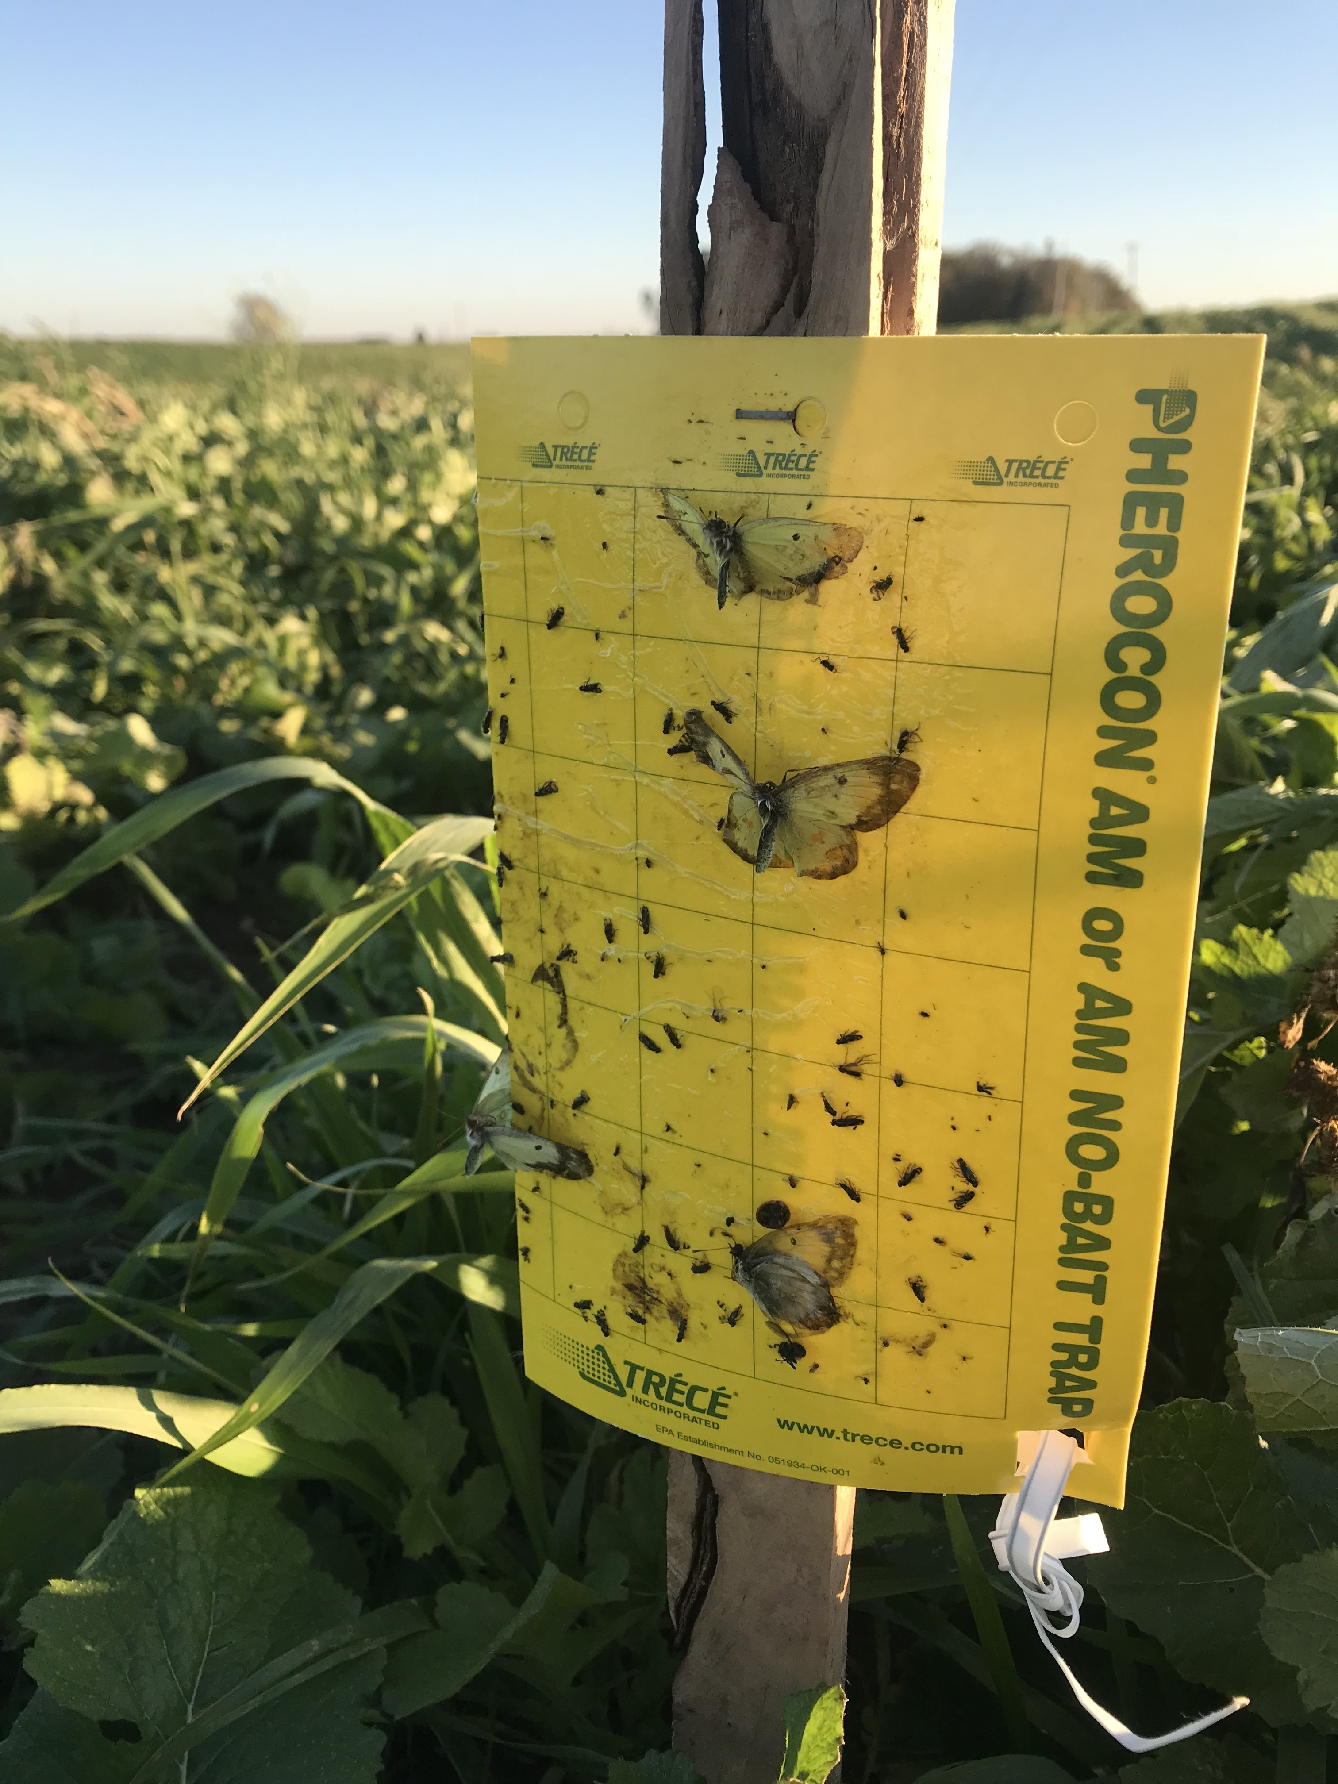
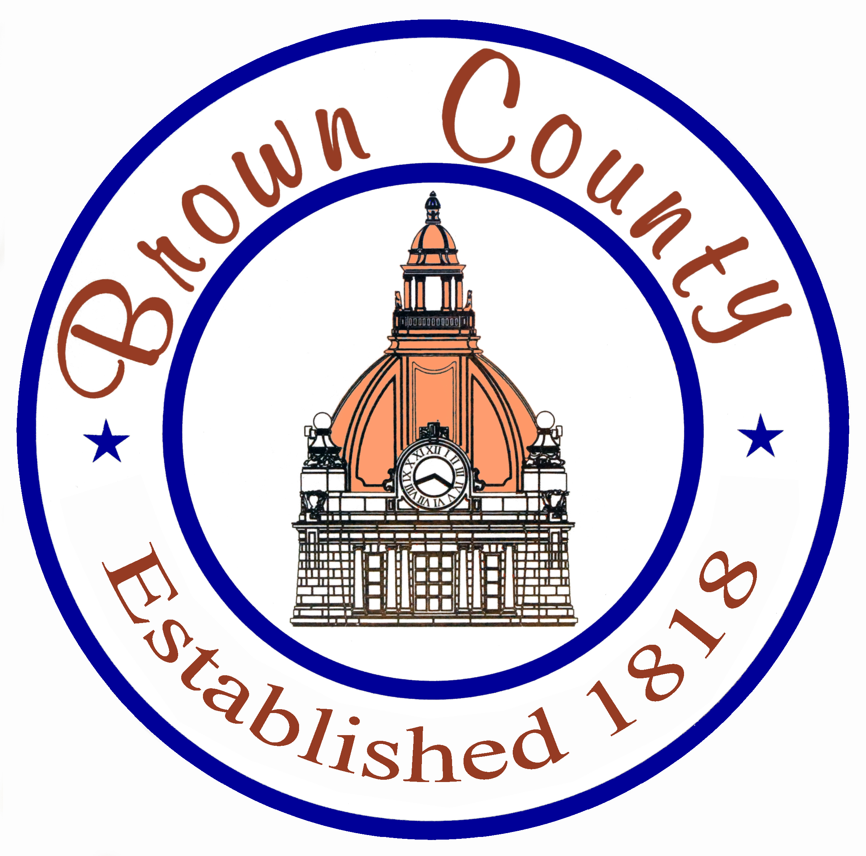
Pilot Project: Diversified Cover Crops for Beneficial Insects & Pollinators – Fall 2019
Jessica Kessler & Patrick Brodhagen, UW-Green Bay; Reena Bowman, US Fish & Wildlife Service; Whitney Pretsby, Fox Demonstration Farms Network; Bobbie Webster, Cofrin Center for Biodiversity
Purpose
Project Locations
To compare beneficial invertebrate populations between diversified cover crop fields, no-till fields with a previous rye cover crop, and a conventional tillage corn field. The primary focus will be to evaluate pest, beneficial, and predatory invertebrate species.
Wiese Brothers Farms
Augustian Farms
Methods
Overview: Seven fields were used in this study. Each field had four sampling locations oriented in a 60 x 60 foot square within each field.
Pitfall Traps: Used to collect ground dwelling invertebrates including insects, spiders, & earthworms. Four small plastic cups with low-toxic antifreeze were placed in each field. A wooden canopy was placed over the top to prevent contamination from rain water. Traps were set for two weeks.
Slug boards: Used to collect slugs, as well as other ground dwelling invertebrates (i.e., centipedes, springtails, spiders, & earthworms). Traps consisted of 4.25 x 5.5 inch cardboard pieces secured to the ground using landscaping staples. Four boards were placed in each corn field and set for two weeks. Mice ate the slug boards in the cover crop fields, rendering the data inconclusive for those fields.
Sticky traps: Used to collect flying insects. The sticky traps were mounted on wooden posts and were placed six inches above the plant canopy. Four traps were placed in each cover crop field and set for four weeks. All traps were set facing north an south. Traps were not set in standing corn fields.
Fields
No cover crop (Ave. cover: <5%) | Conventional tillage corn silage. One field sampled.
Rye preceding no-till (Ave. cover: 25, 50, & 75%) | No-tilled corn silage into varying densities of rye cover crop. Three fields sampled. 25% rye residue 50% rye residue 75% rye residue
6 species mix (Ave. cover: 95%) | Diversified cover crop mix. Three fields sampled, all planted with same seed mix. Legume: Crimson clover, berseem clover Grass: Barley, sorghum x sudan grass Brassica: Radish Broadleaf: Sunflower
Results
Please note that this was a pilot project. The sample size was too small to make definitive conclusions about the project. However, the results suggest that further monitoring would be beneficial to develop a better understanding of the impact that cover crops have on beneficial invertebrate populations. Additionally, weather conditions in the Fall 2019 cropping season were unprecedented; collected data may not be representative of typical invertebrate populations.
Beneficial insects: earthworms, ground beetles, spiders, ants, butterflies, ladybugs, lacewings, springtails, harvestmen, and wasps
Harmful insects: slugs and crickets
Project Partners
Thank you to the two participating farms!
Wiese Brothers Farms and Augustian Farms
The 6 species cover crop mix seems to have hosted the widest array of invertebrate species, as well as vertebrate species such as mice.
Graphs and charts are shown in the following slides.

Slide 2
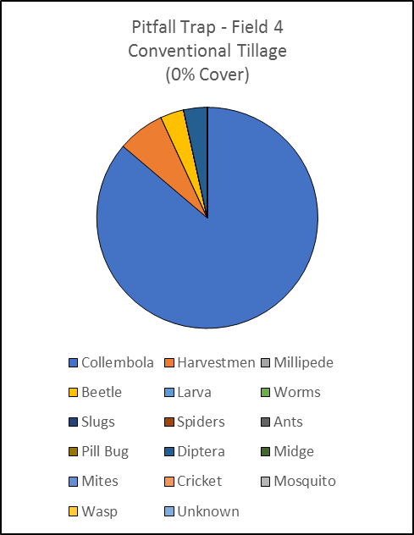
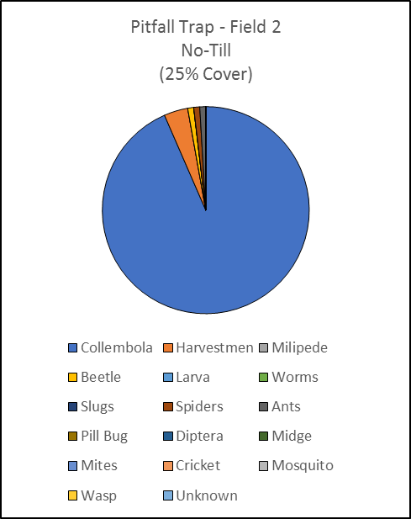
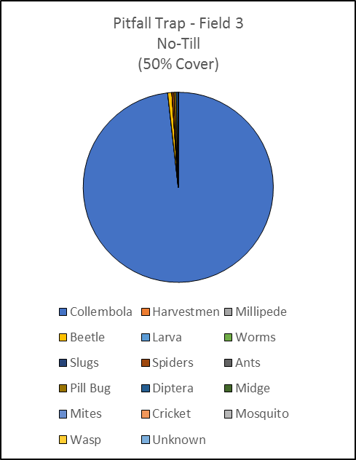
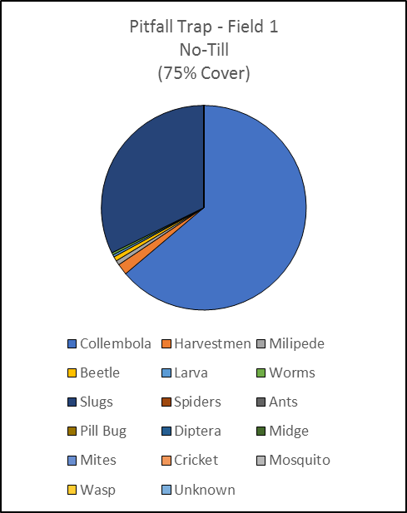
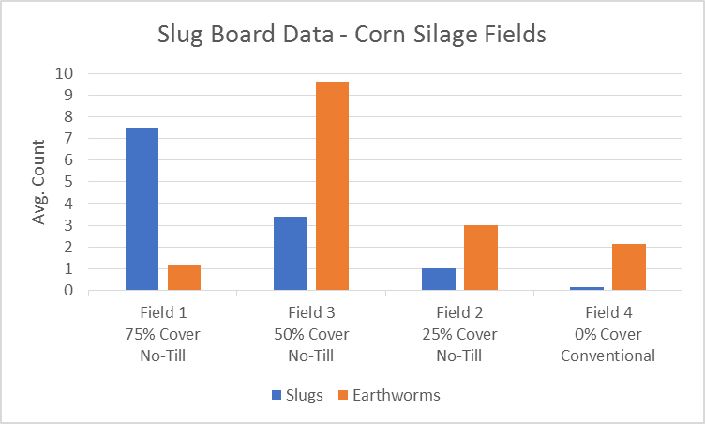
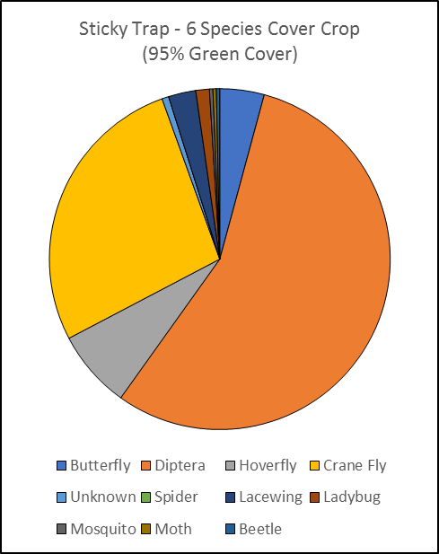
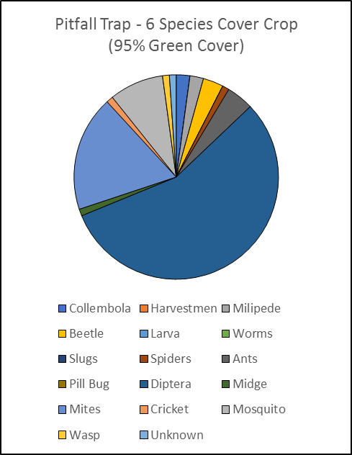

Slide 3
